Slide 2
A-HEAD project arises as a response to automotive market trends, promoting advanced interactive solutions for the interior of vehicles through the development of new textile structures and integration of projection and high-performance technologies in the headliner for an interactive environment.

Slide 4
R&D –Individual Project Nº 45215
Start Date: 01/01/2020
Finish Date: 31/12/2021
Duration: 24 months
Budget:

Slide 5
Development of advanced solutions for projection and actuation on the automotive headliner integrating the ability to reproduce multimedia content and/or creating lighting effects in the vehicle's headline structures.
The main goals were the Development of:
    Integrated projection systems
    Intelligent systems for shape change
    Dynamic and intelligent control systems

Slide 6
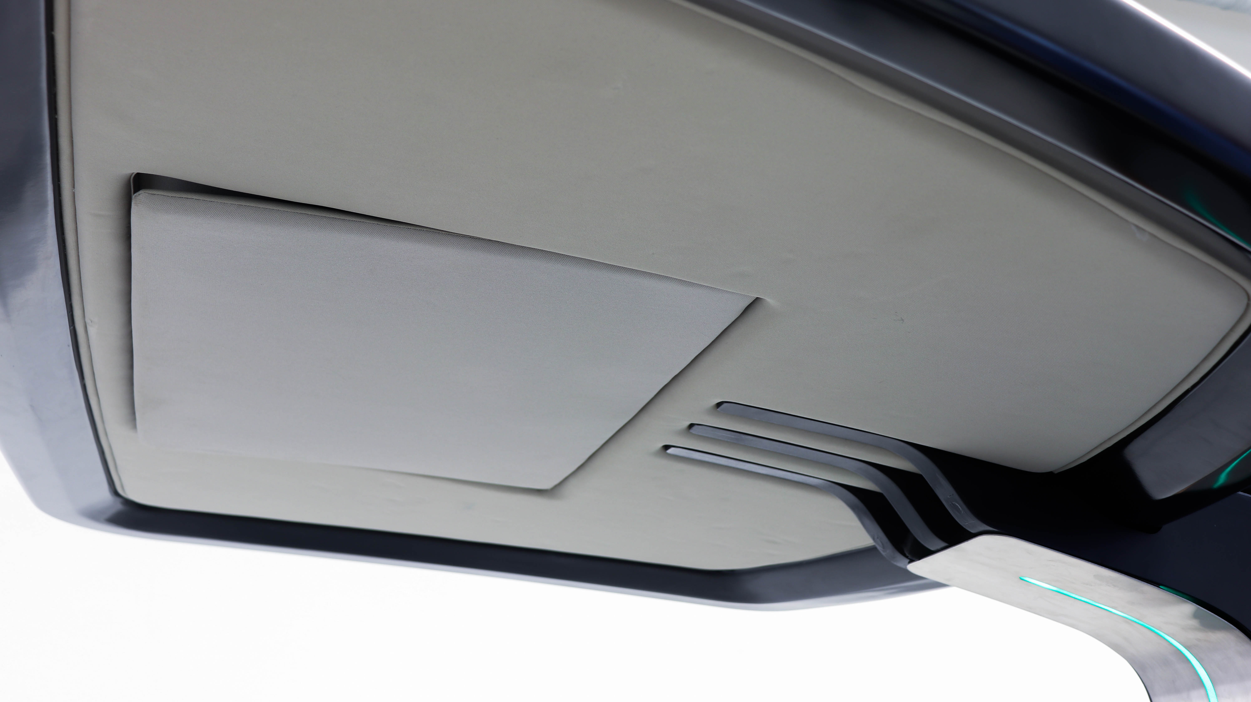
Development of Solutions for front projection
Fibers, textile structures and coatings for improved front projection
Different types of materials were selected and tested, to identify those that would have the most potential and could be used in the form of filaments and the consequent production of textile structures capable of reflecting light. Different polymeric formulations, as well as technologies for its application, have been developed and tested with the materials previously selected for application in coatings/and or textile finishes. It was also developed a methodology to evaluate the solutions developed.
Textile structures were produced using the most promising fibers produced. Subsequently, the best coating was applied to this solution.

Slide 7
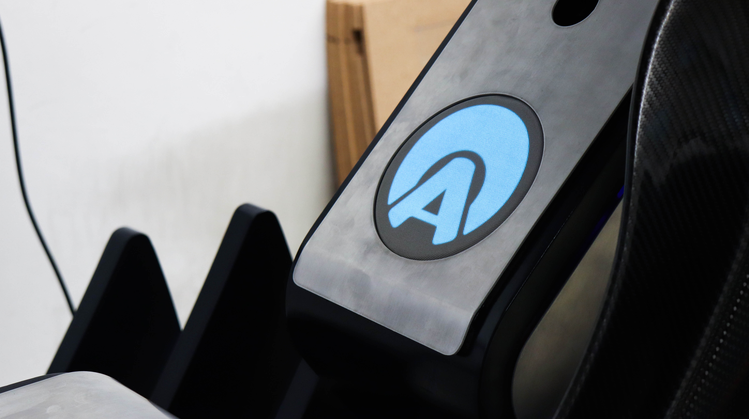
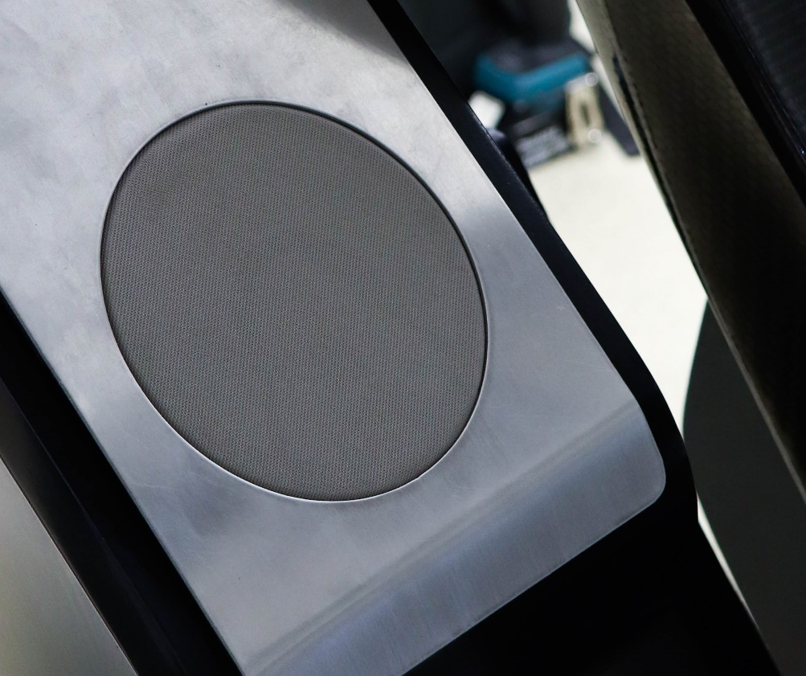
Development of Solutions for rear projection
Fibers and textile structures for improved rear projection
Different types of materials were selected and tested, to identify those that would have the most potential and could be used in the form of filaments and the consequent production of textile structures capable of transmitting light.
Textile structures were produced using the most promising fibers produced.

Slide 8
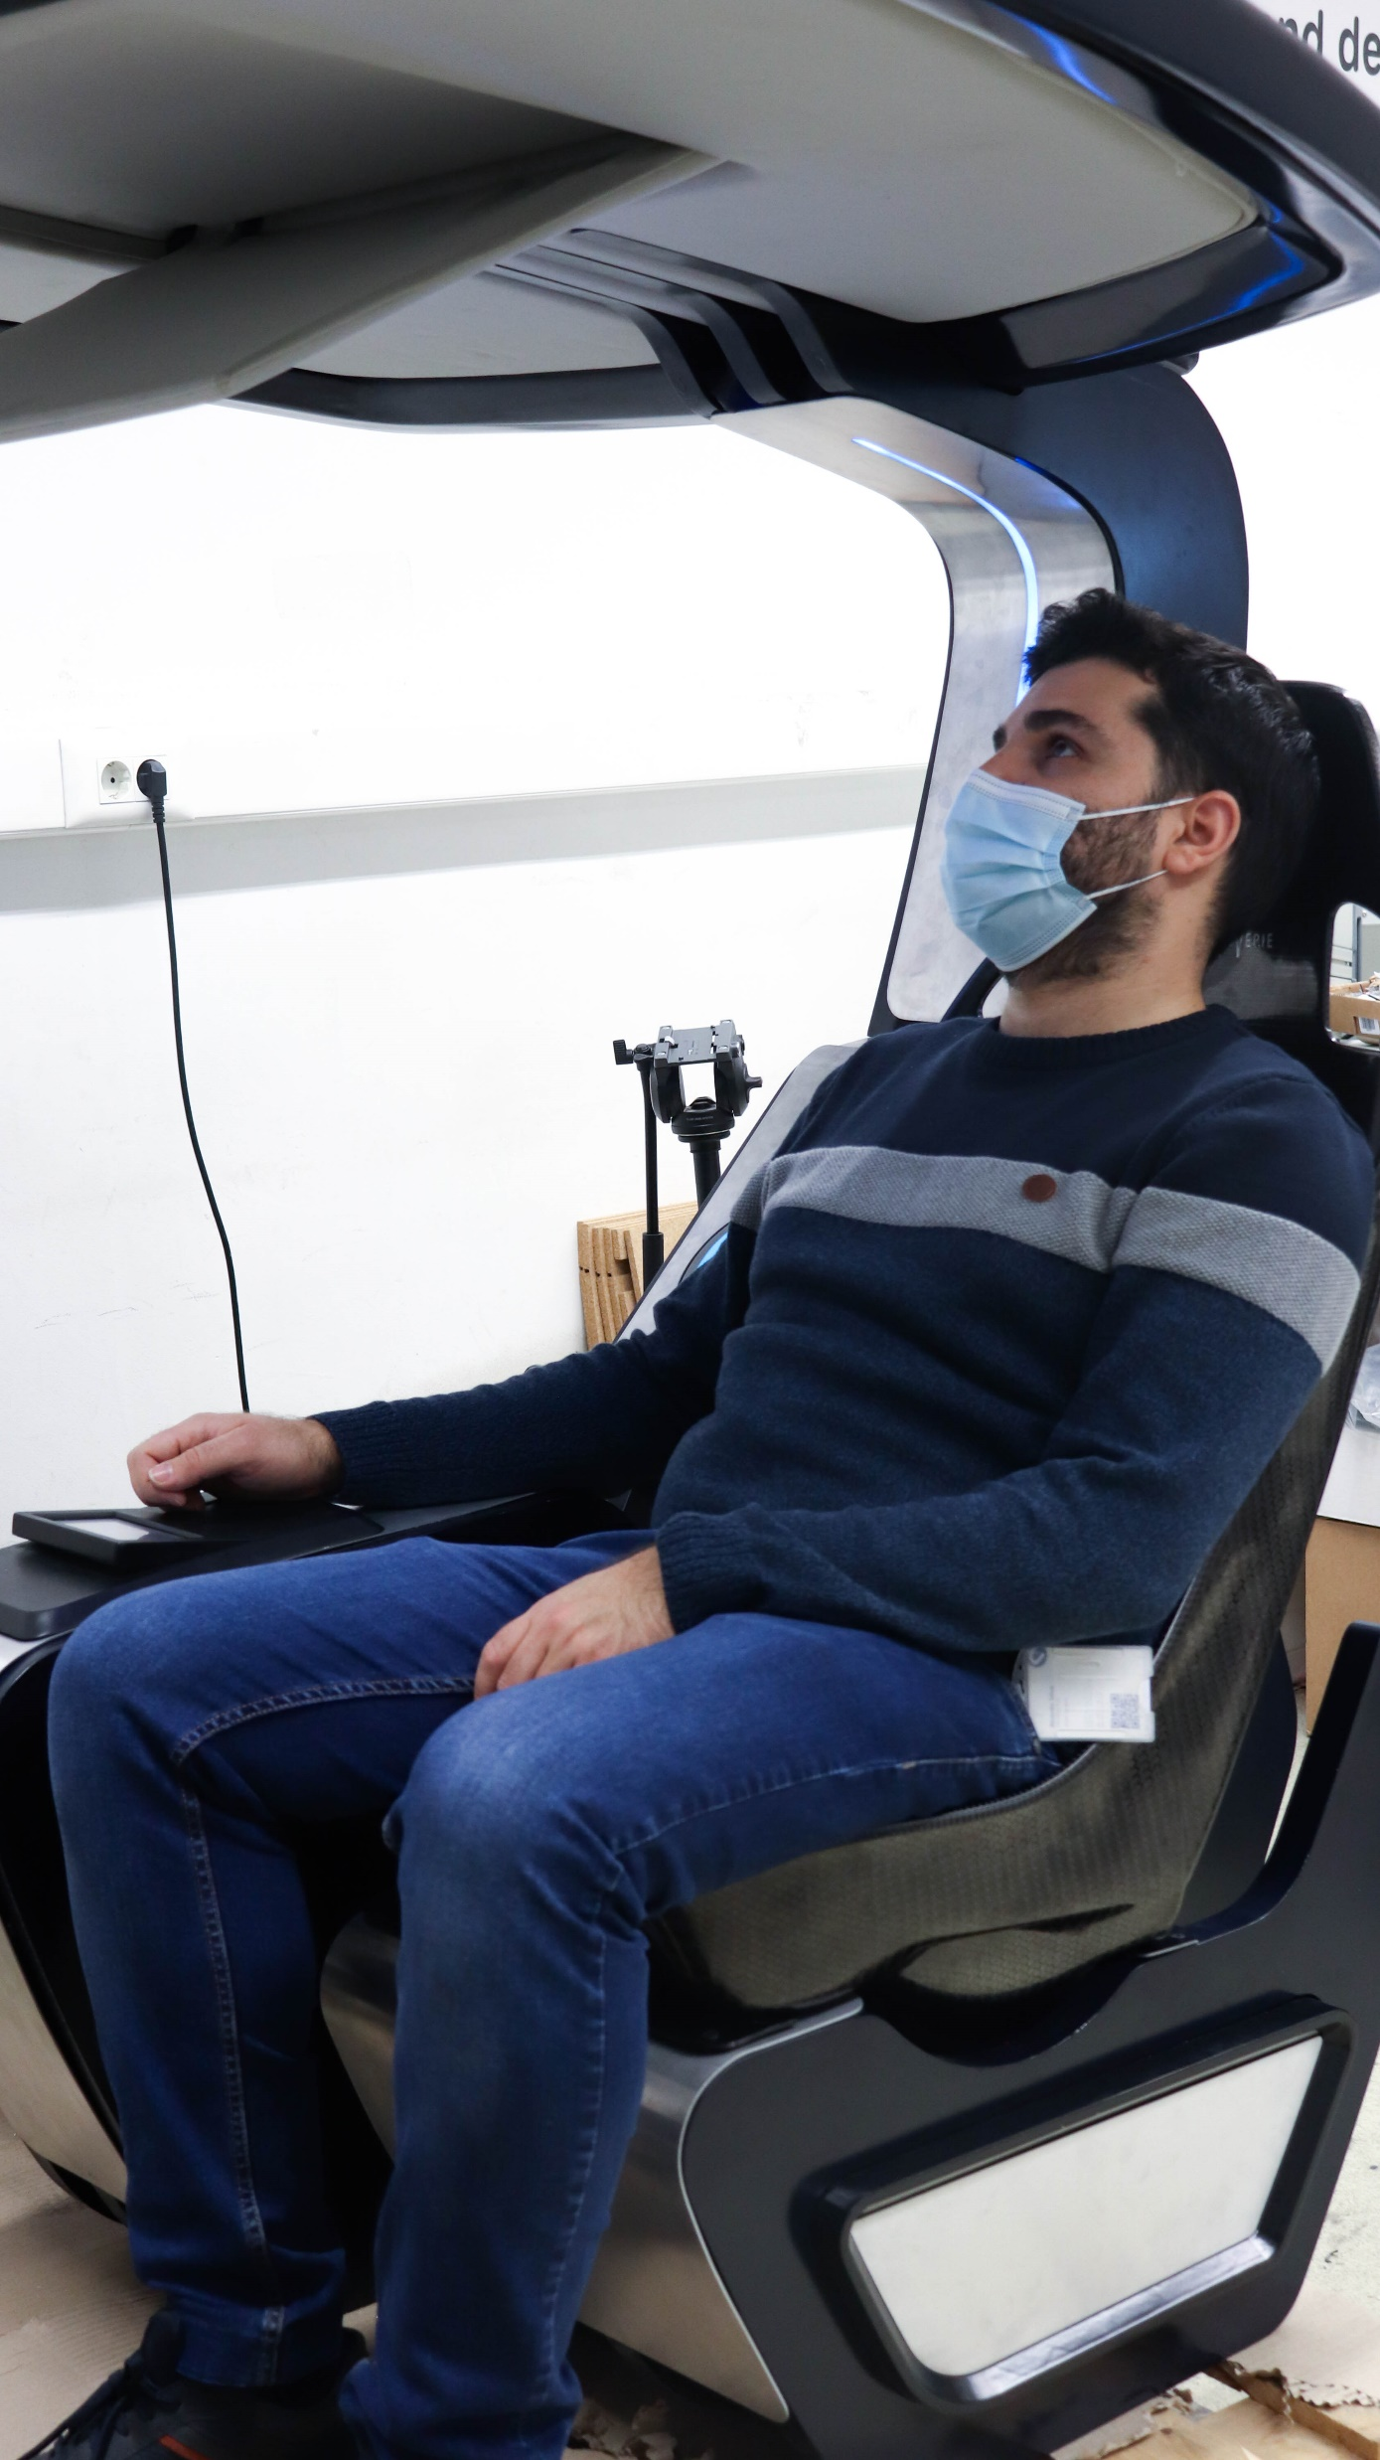
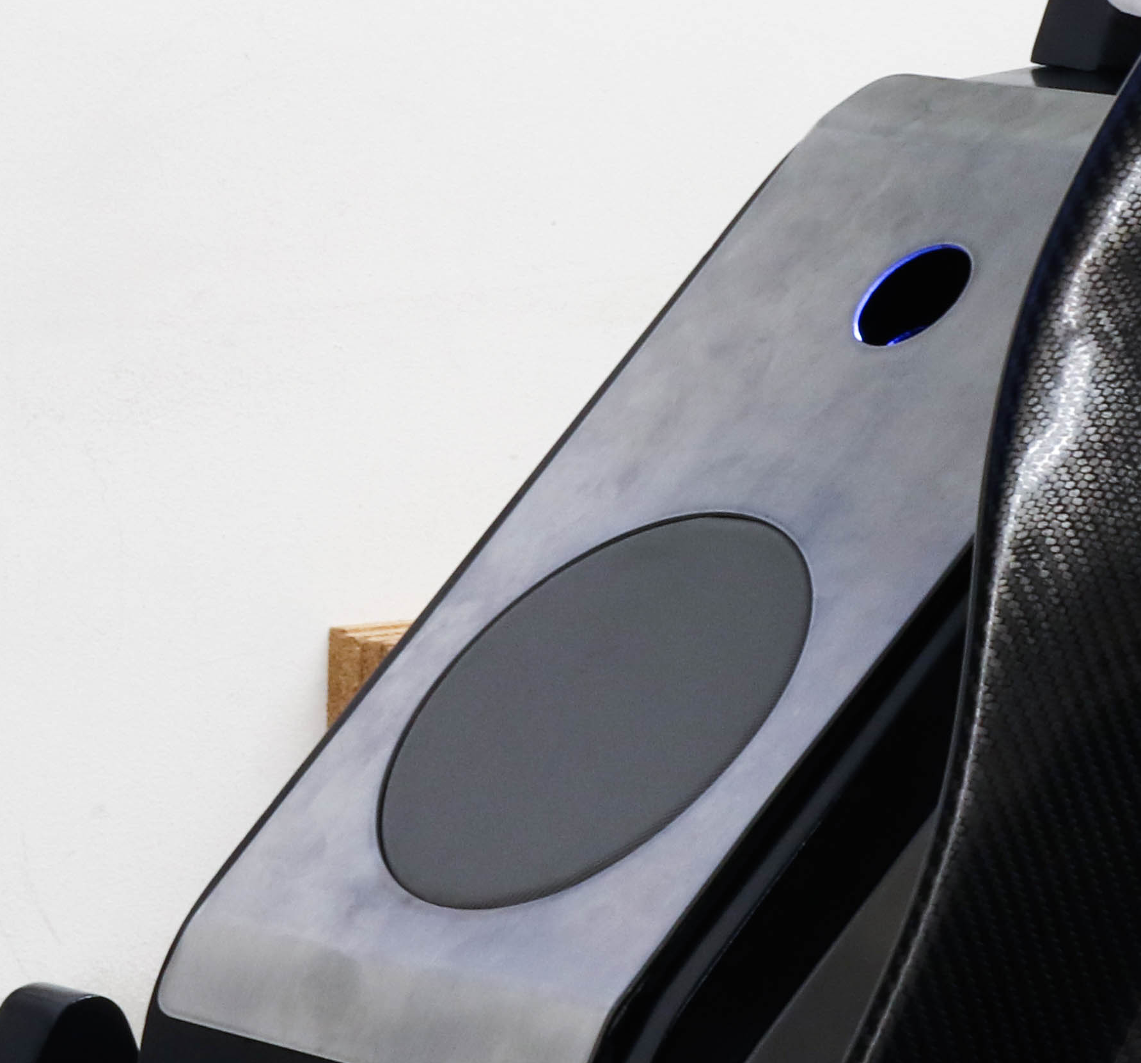
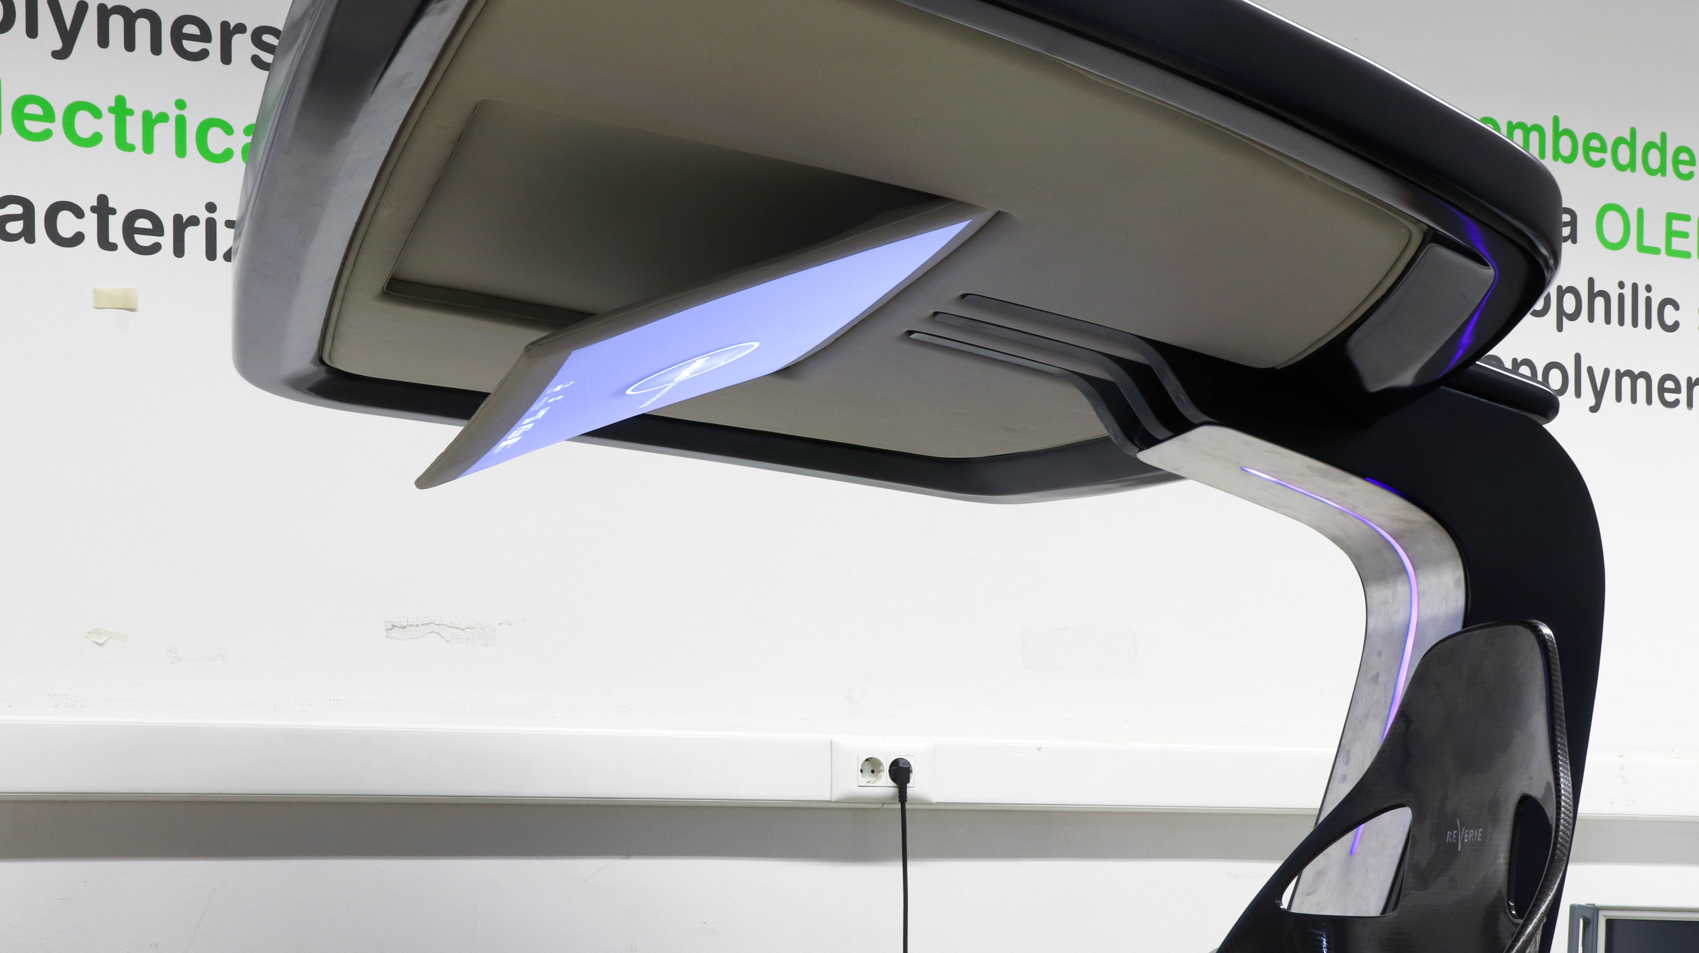
Development and integrations of Projection systems
Projection systems were tested and developed, with the possibility of integration in different points of the interior of the vehicle. In order to create a uniform projection and circumvent the limitations of resolution and projection range of compact projection systems. Studies were also carried out to determine the most suitable places inside the vehicle for this integration and to assure the ergonomics of its usage.
A module was developed and adapted in the central console in order to allow the integration of projection systems, since, due to its characteristics, it can’t be laminated in textile structures.

Slide 9
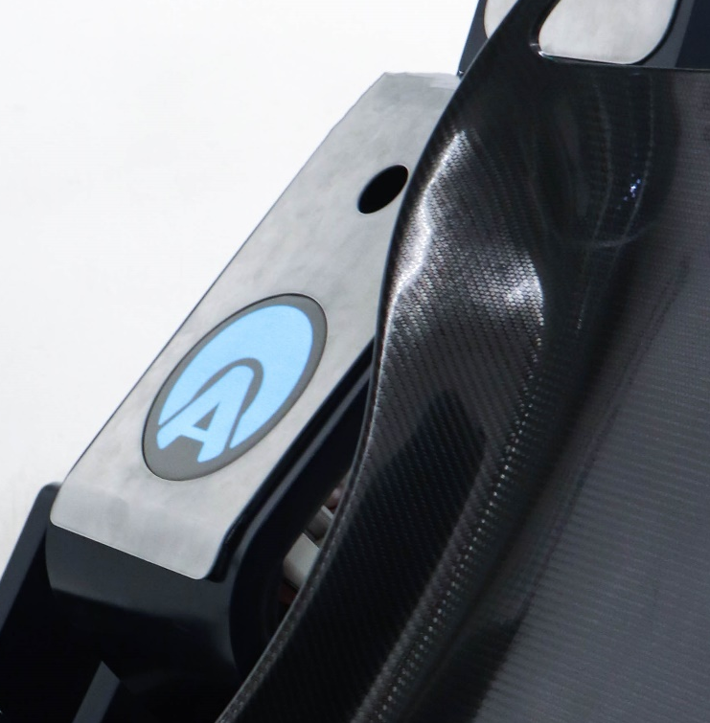
Intelligent systems for shape change
Intelligent systems for changing shape were studied using external stimuli, using shape memory materials. The use of this type of intelligent materials allowed the development of extremely compact, silent and low weight solutions, with a high potential for application in the automotive industry.

Slide 10
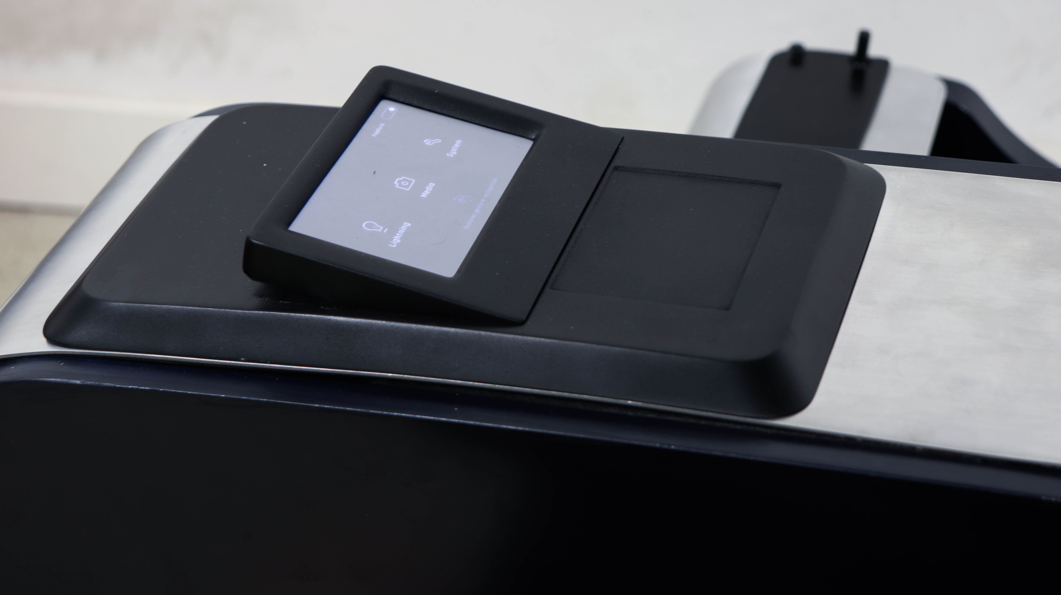
Dynamic and intelligent control systems
A sensor systems that includes flexible sensors that can be laminated in the textile structure was developed. These sensors allow the detection and recognition of gestures in three dimensions, by detecting variations in capacity, light or radar. The gestures detected by the sensor system are used as one of the interface methods with the other systems that constitute the global solution. It was also developed the electronic actuation and intelligent control systems with high processing capacity and prepared for automotive applications.

Slide 11
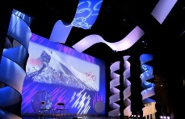
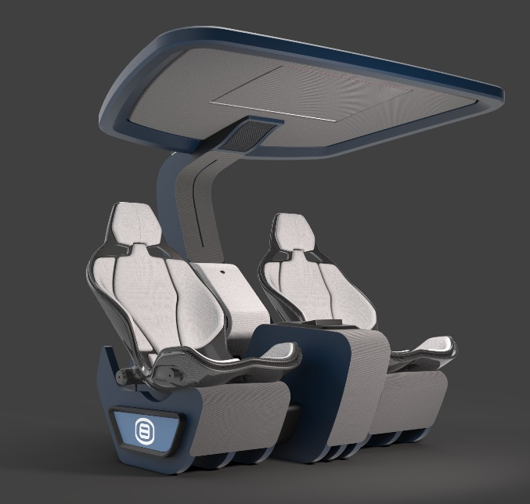
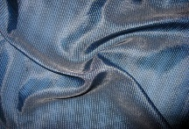
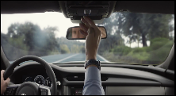
A-HEAD Demonstrator
Research Lines
Integrated projection systems
Demonstrator with textile structures, projection finish and headliner performance for interactive environments
A
Integrated projection systems:
Yarn, fibers, textile structures and finishes for improved frontal projection;
Thread, fibers and textile structures for improved rear projection.
Shape memory materials
A
Intelligent systems for shape change:
Shape memory materials in planar structures;
Electronic systems for control of structures.
B
Dynamic and intelligent control systems
B
Dynamic and intelligent control systems:
Advanced sensing systems (by gestures);
Intelligent actuation and control systems.
C
C

Slide 12
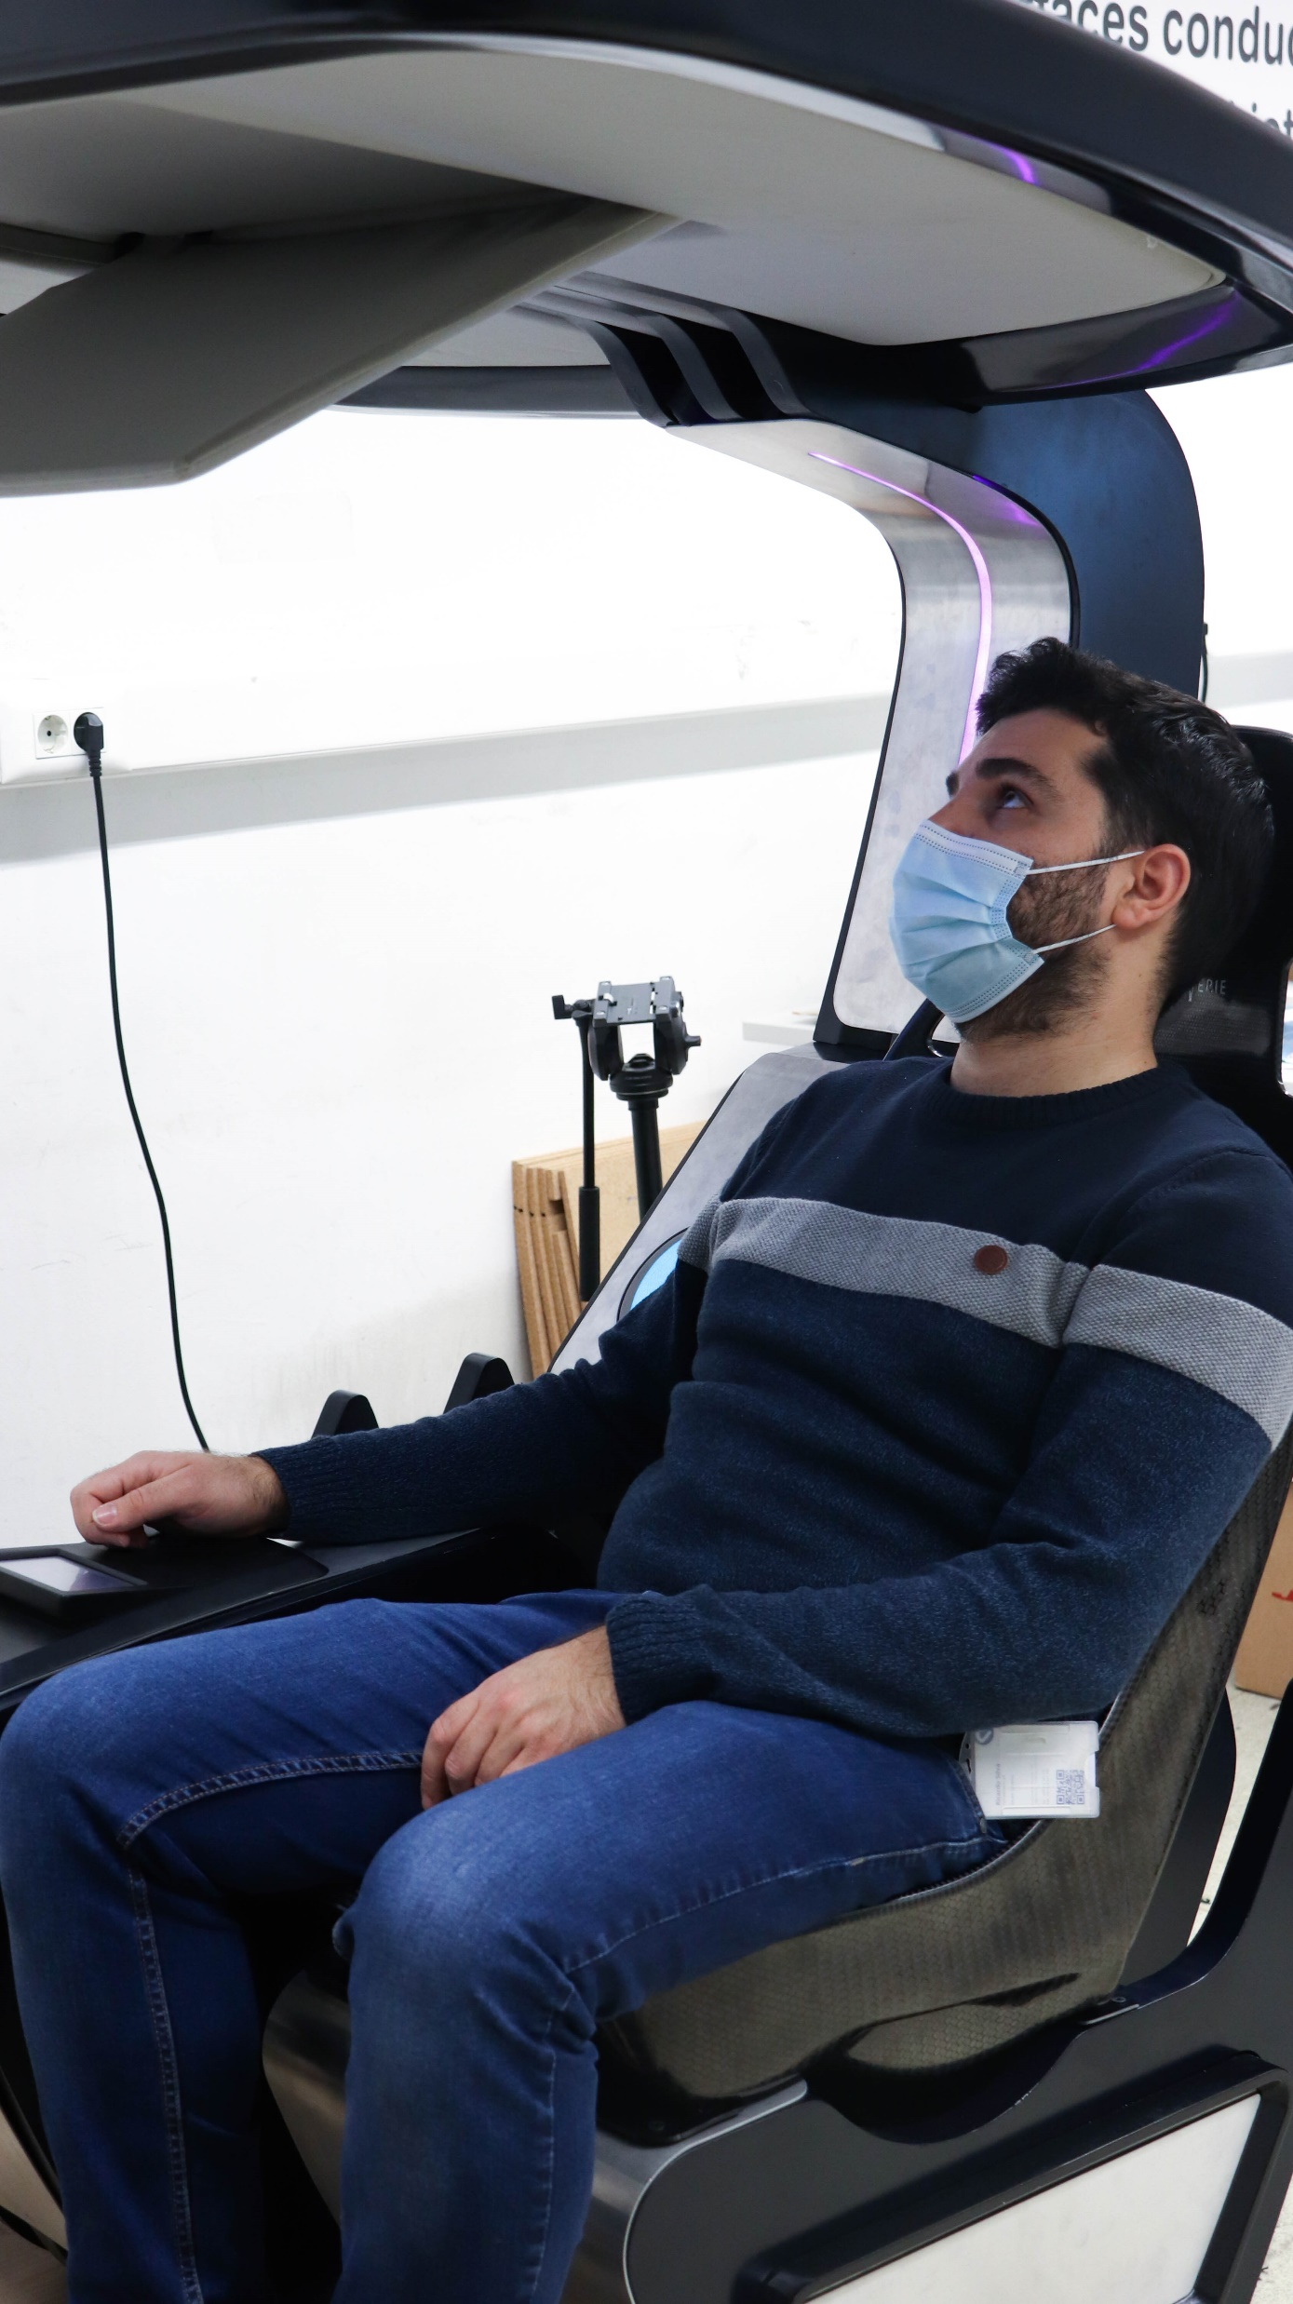
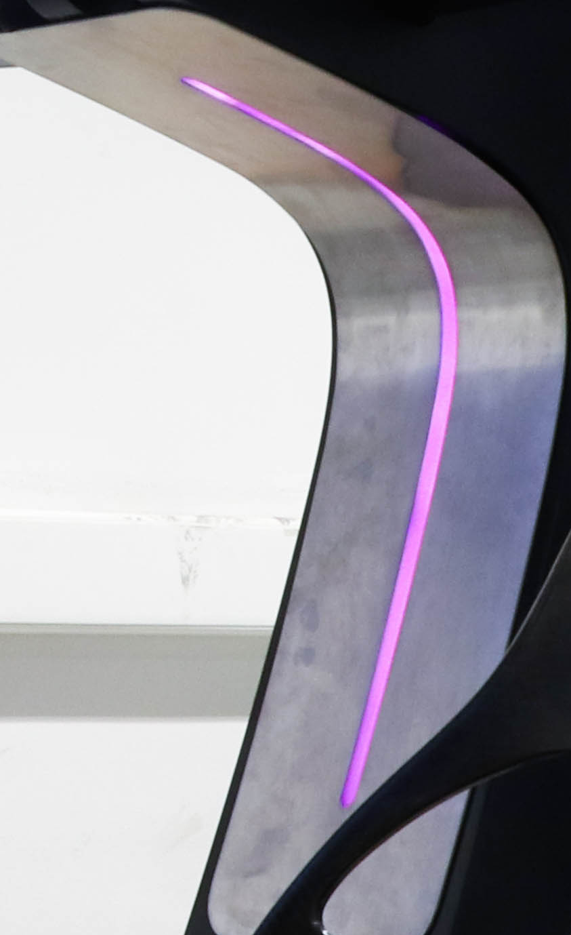
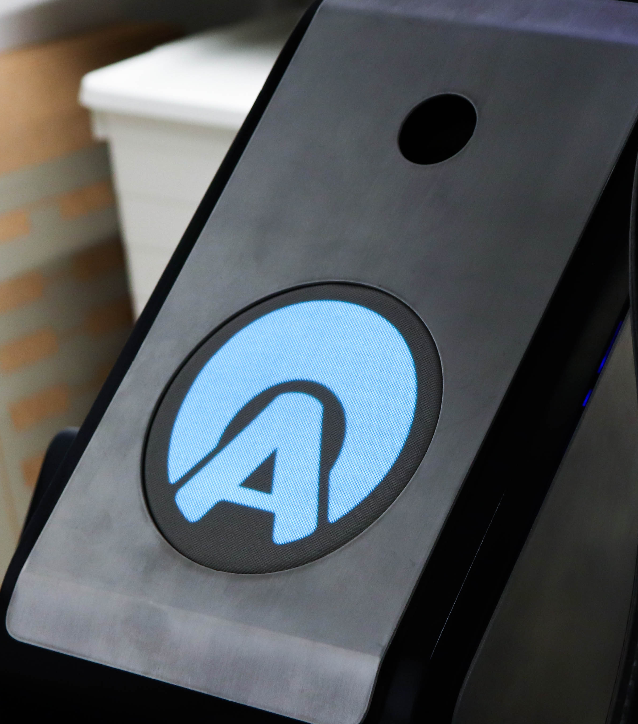
A-HEAD Demonstrator
  Rear-projection and RGB lighting
  Textile Structure for Rear Projection
  Textile Structure for Front Projection
  Reclining Projection Screen
  Projection system
  Gesture Recognition
  Tactile Interface
  Intelligent systems for shape change

Slide 13
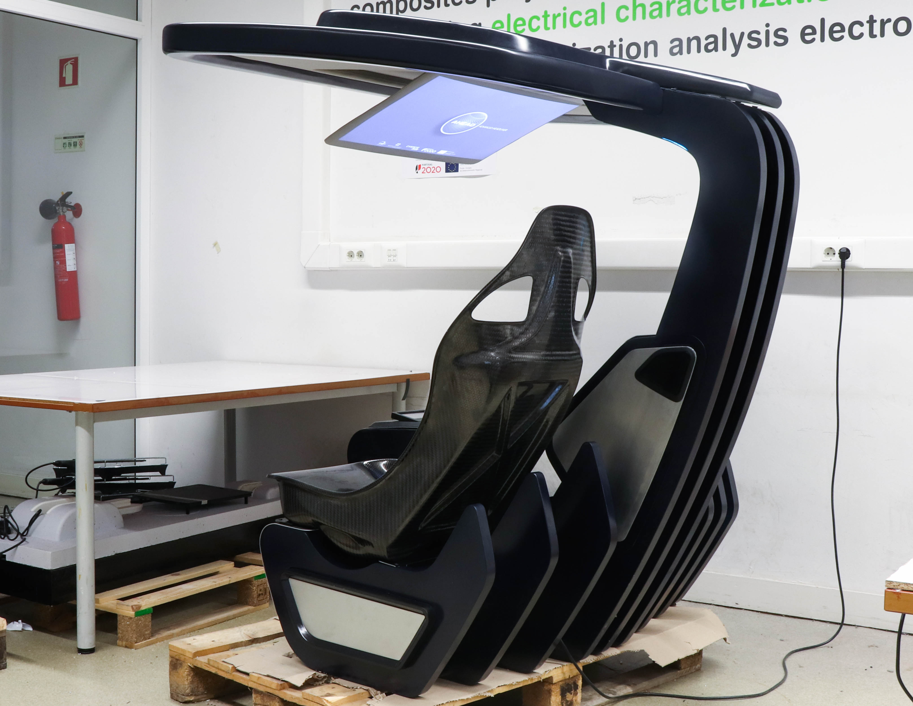
A-HEAD Demonstrator

